Slide 1

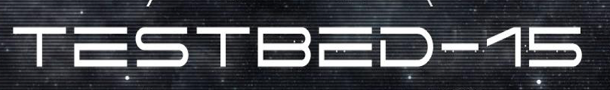
Federated Cloud Analytics
Identity Management & Access Control
Processing
Data Center & Discovery

Slide 2
FCA in 3 Parts
Federated Cloud Analytics
Introduction to the concepts of Federation and Federated Clouds; what is a Federation Manager, along with the different deployment models, and their impact in governance models.
Federation Manager functionality, such as:
Security
Membership Management;
Policy Management;
Portability and Interoperability.
EOC, SCALE, SEED
The potential for the OGC Web Processing Service (WPS) Interface Standard as an API to a workflow automation service for managing job execution involving multiple containers in the Scale Data Center Environment;
Using WPS as a general frontend to workflow automation with containers
The suitability of the OGC Web Processing Service (WPS) 2.0 as an Application Programming Interface (API) for Cloud analytics;
Using OGC Web Services (WS) as analytics data sources and sinks;
Federated Clouds Provenance
Study of application of Distributed Ledger Technologies for managing provenance information in federated clouds
Notes:
EOC – Earth Observation Cloud work done in previous testbeds was compared to an NGA set of software for Data Centers
The Provenance work is ongoing and should be available within the next weeks.

Slide 3
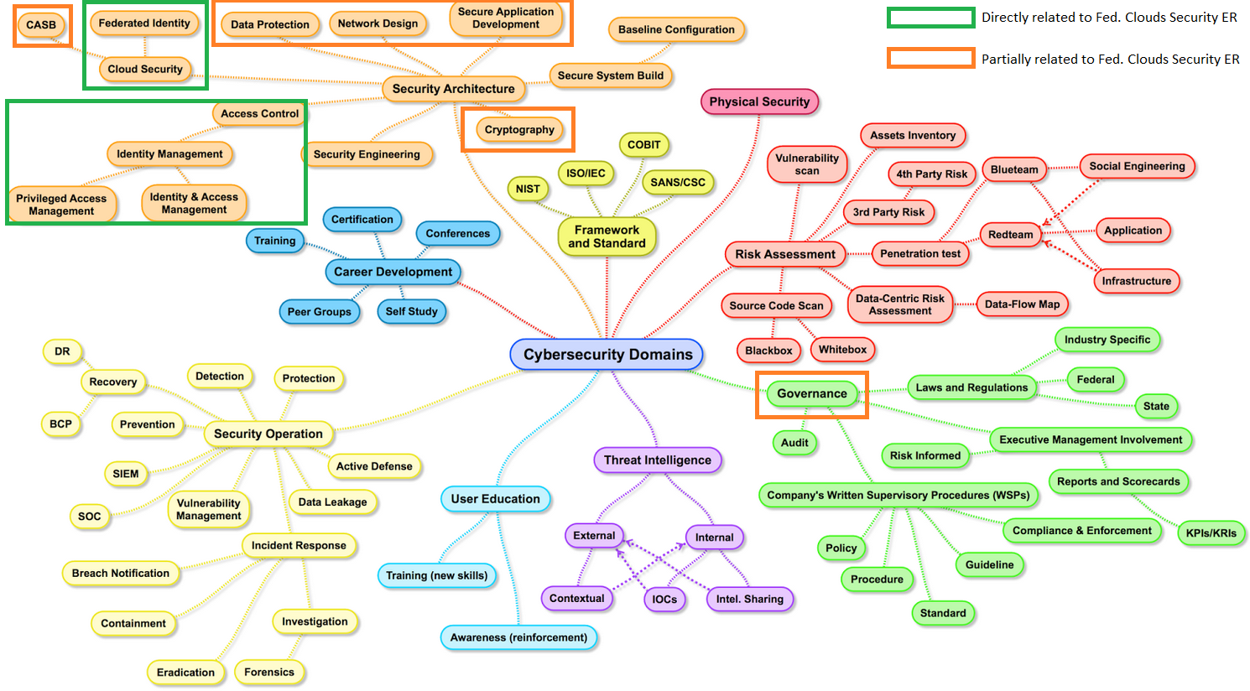
A CyberSecurity Mindmap
Sources: (1) Henry Jiang – Security Expert for Bank of America (2) CISO 2016 Mindmap
Notes:
This is a Mindmap of the CyberSecrity Domain.
The items highlighted in Green are those that were addressed in this security work, the ones in red were partially touched upon.

Slide 4
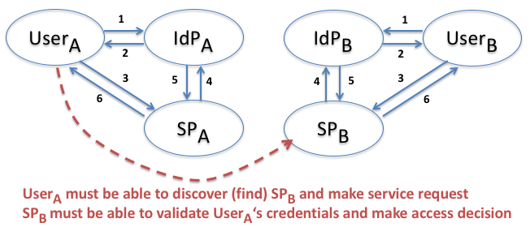
Federation Consists of Several Fundamental Operations
Establishing identity within a federation
Associating a "home" identity with a "federation" identity
Discovering which services/data are available within a federation
Making a "remote" service/data request
Enabling a service/data owner to make a valid access decision based on federated identity and authorizations
Notes:
User A is a member of Federation A, and is identified by the Identity Provider A, to get resources from the Service Provider A. But this work was looking at allowing User A to reach into Service Provider B.

Slide 5
Inter-Federation
Users from both Federations should be able to interact with Service Providers that do not reside within their “home” federation
Federation Manager #1 provides an abstraction API that FM#2 can use. FM#2 acts as a SP for FM#1 (the service would be the whole Federation)
Tested use cases:
Federation Manager #2 delegates authentication to FM#1 (acting as external IDP)
Federation Manager #1 API is used to propagate information about resources on Federation Manager #2 side

Slide 6
Future Work on Federated Clouds Security
Inter-Federation: Definition of a reference Federation Manager API covering all identified use cases
Policy Enforcement: Analyze the usage of Security Gateways to facilitate integration of OGC Web Services within distributed PDP/PEP authorization schemes.
Secure Workflows: extending on Testbed-15 and Testbed-14 efforts
Accounting and Billing capabilities in Inter-Federation scenarios

Slide 7
2 Totally different Approaches to Federation Management
One is fully distributed
the other is fully centralized
Notes:
Two federation managers with differing approaches have been inspected and paired in Testbed-15.
- FM#1 is a standalone component offering authentication and authorization to which nodes can subscribe; its service remains visible to clients which need to approach FM#1 first, and then approaches the target service as usual.
- FM#2 is tightly integrated in a fully distributed, location-transparent service, and clients accessing the service do not need to perform an extra step when invoking the federation service.
Both architectures lead to different technical consequences which have been investigated. As such, we now have a suitable basis for further investigation on the interoperability between and across federations.

Slide 8
Scale Data Center Environment
DC/OS is deployed on a private cloud cluster
SCALE data center deployed on DC/OS
Distributed storage by S3 or NFS
Processing tasks (jobs) implemented as docker containers
SEED is a specification of a manifest format for dockerized algorithms
Tasks are chained together into recipes
Allows combination of algorithms written in different languages as long as they can run in docker
http://ngageoint.github.io/scale/
Docker provides algorithm containerization
Apache Mesos enables optimum resource utilization.
Algorithms
Docker
SCALE
DC/OS Cluster
Cloud VMs/Machines
Notes:
Apache Mesosphere is the Distributed Cloud Operating System

Slide 9
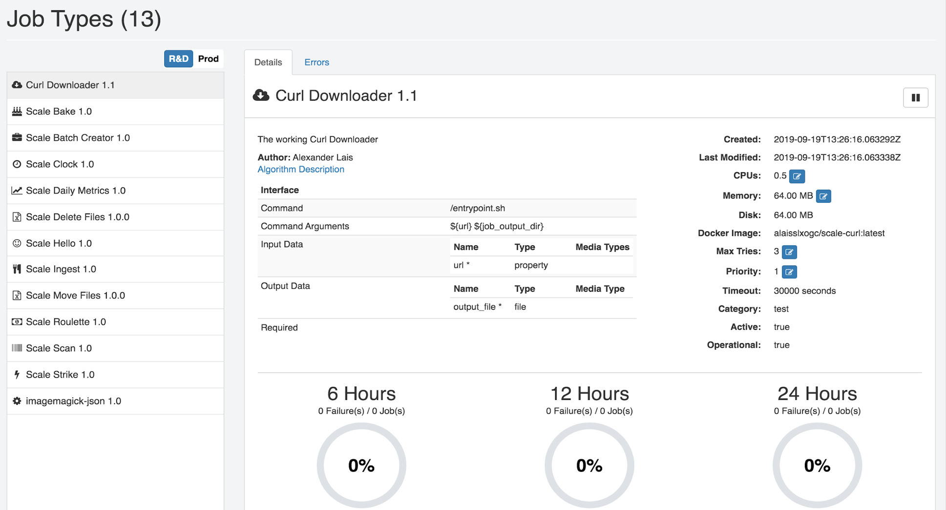
Algorithm Definition in SCALE

Slide 10
WPS REST facade for SCALE Datacenter
Map SCALE Jobs & Recipes to WPS processes
Map WPS 2.0 Core Operations/REST endpoints
GetCapabilities
DescribeProcess
Execute
GetStatus
GetResult
Demo SCALE Job
Docker image using curl to download coverage
Literal input: WCS url
Complex output: coverage file

Slide 11
Recommendations and Future Work
EOC processes developed in earlier testbeds tend to be more flexible and more interoperable.
SCALE is a powerful tool and can be used in large data center environments
Using SEED to catalog docker images - supporting the discovery and consumption of discrete units of work contained within a Docker image
SCALE jobs can be mapped to WPS processes enabling a standardized description and execution of SCALE jobs
Investigate where SCALE jobs could either be combined to SCALE recipes or executed as single WPS processes

